Slide 1

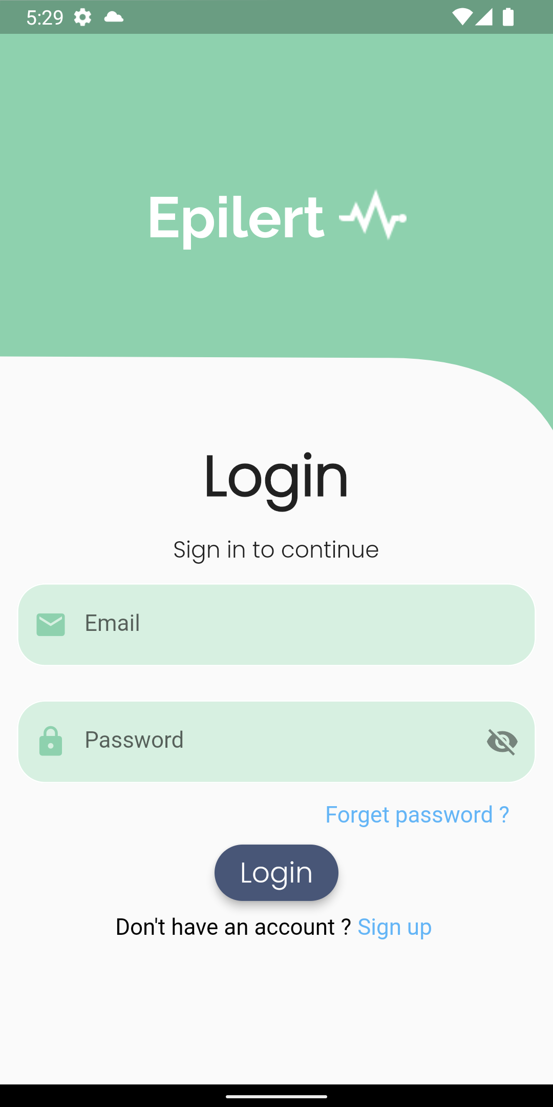

Faculty of Computers & Artificial Intelligence
EPILEPSY SEIZURE ALARM DEVICE
Learn More

Slide 2
Team Member
1-Nadeen Ashraf
2-Mennatullah Hany
3-Hager Hamdy
4-Ghada Ahmed
5-Amaal Abdelazeem
6-Dina Yousry
7-Radwa Sayed
8-Alaa Ahmed
9-Karim Ehab
Under Supervision:
Dr.Hamada Nayel.

Slide 3
Introduction
Current Solution
Project Description
Design & Tools
Implementation& Run
Application and Models
Testing
Future work
Conclusion
1
2
3
4
5
6
TABLE OF CONTENTS
7
8
9

Slide 4
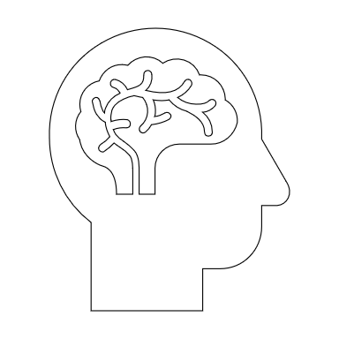

INTRODUCTION
Epilepsy is a disorder of the central nervous system that causes brain activity to become abnormal.
Epilepsy seizure occurs when burst of electrical impulses escape their normal limits and spread to neighboring areas and create uncontrolled storm of electrical activity. Electrical impulses can be transmitted to muscles. The contraction process begins when electrical impulses reach at intervention zone. Intervention zone is neuromuscular junction.
Learn More

Slide 5

CURRENT SOLUTION
01
02
03
Magnetic Resonance Imaging (MRI) can show if there is any scar, tumor, or lesion in the brain that may be causing seizures.
Seizure Alarm app for application watch but it was not preferred as it gives alarm of seizure for normal movements.
An Electroencephalogram (EEG) can show irregular activity in the brain that can indicate seizures.

Slide 6
Project Description
The EMG sensor captures muscle activity signals.
The ESP32 processes the signals and transmits them to the Mosquitto broker using Wi-Fi and MQTT.
The Flask API receives the data from the broker.
The API preprocesses the data and feeds it into the deep learning model.
The model analyses the data and generates a seizure prediction.
The API stores the prediction and any relevant data (timestamps, etc.) in the Firebase database.
The Flutter application retrieves data updates from the Firebase database and displays seizure alerts to the user.

Slide 7


Design and TOOLS
Learn More

Slide 8
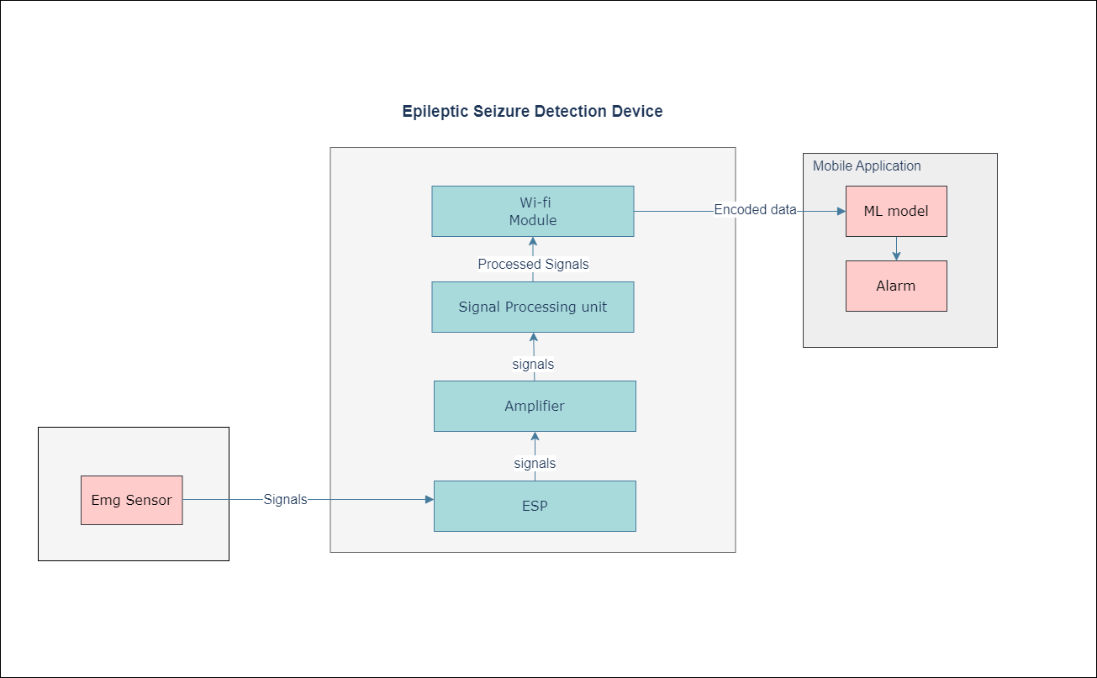
Block Diagram

Slide 9
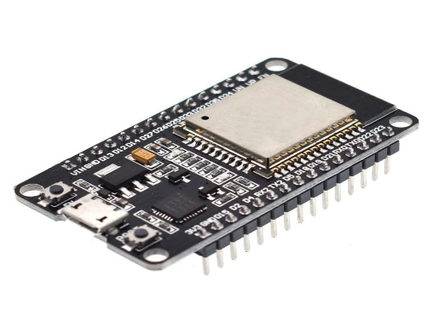
ESP32 microcontroller
is a microcontroller that is designed to provide wireless connectivity and processing power for a wide range of applications.
The ESP32 also includes a variety of peripherals, such as Wi-Fi, Bluetooth, and Ethernet interfaces, as well as GPIO pins and Analog-To-Digital converter.

Slide 10
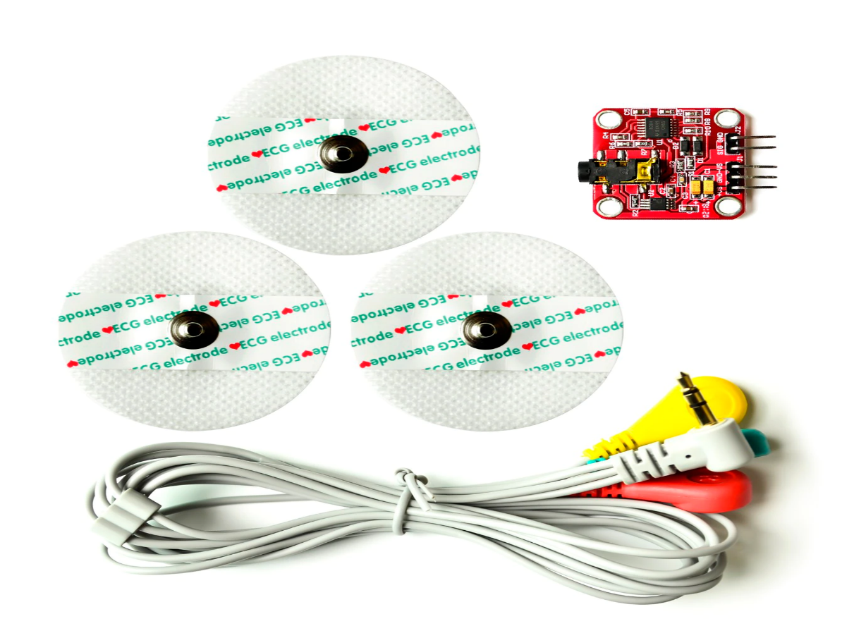
EMG sensor kit
This Muscle Sensor from Advancer Technologies measures, filters, rectifies, and amplifies the electrical activity of a muscle and produces an Analog output signal that can easily be read by a microcontroller, enabling novel, muscle-controlled interfaces for my project.
Sensor has 3 (Green, Red and Yellow) electrodes connect to the module for transmitting electrical signals from the muscle motion.

Slide 11
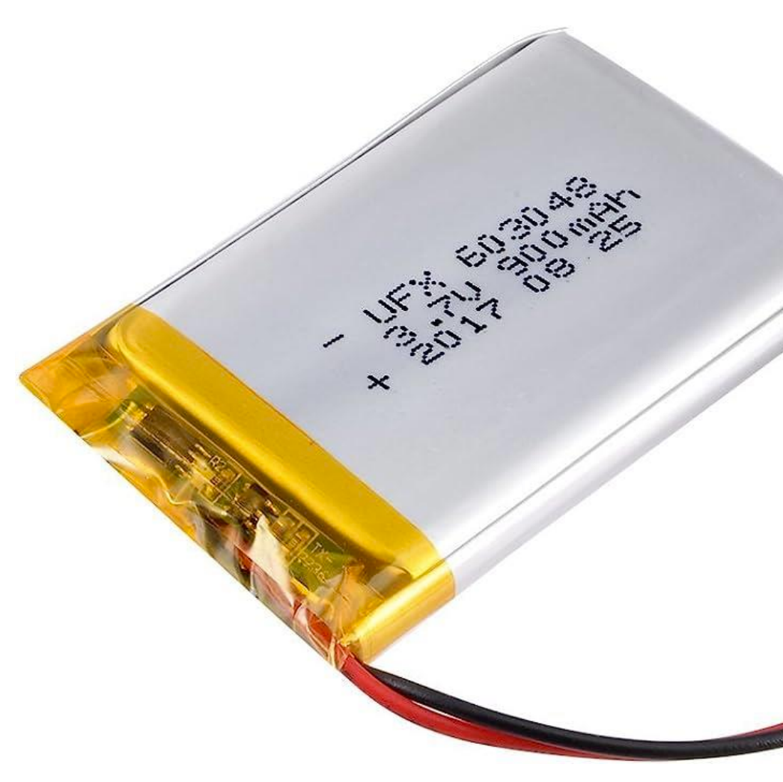
Rechargeable lithium polymer battery
These batteries require special charging. Do not attempt to charge these with anything but a specialized LiPo charger.
Battery includes built-in protection against over voltage, over current, and minimum voltage.

Slide 12
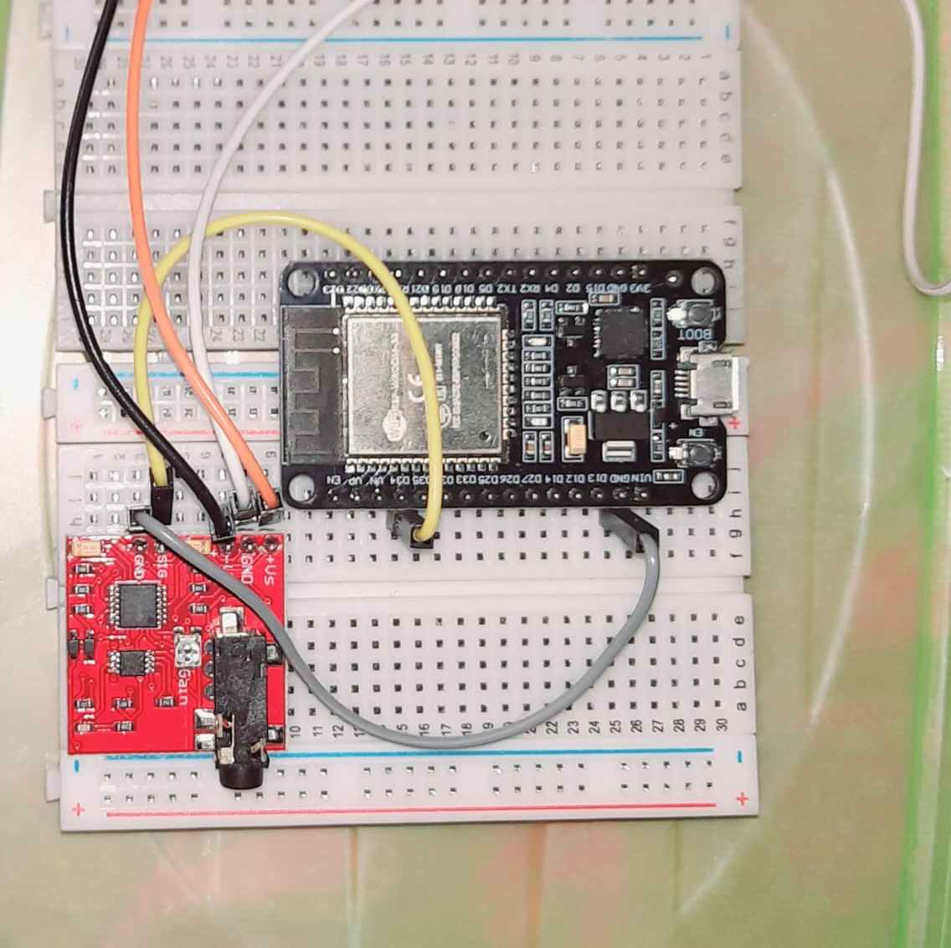
ESP32 – Microcontroller and EMG sensor

Slide 13
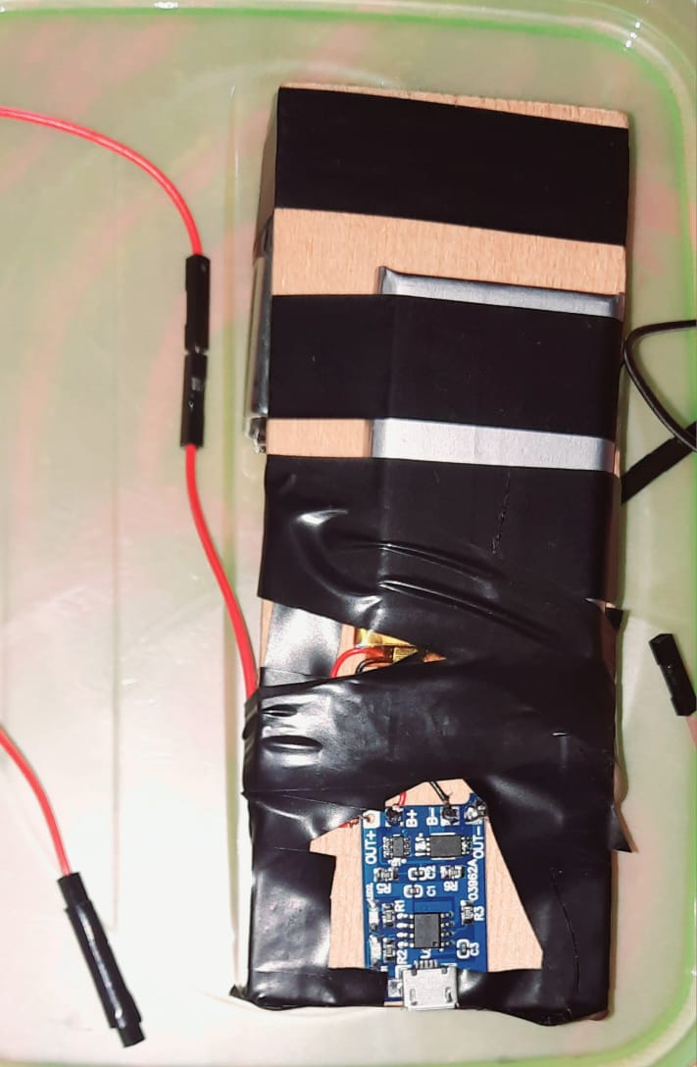
ESP32 – Microcontroller and EMG sensor

Slide 14
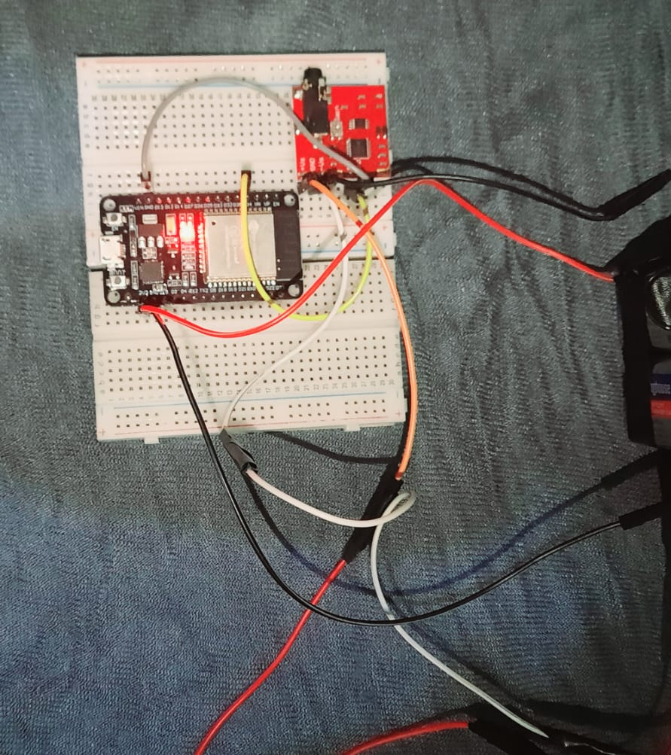
Connect ESP32 to the breadboard.
Connect EMG sensor to the breadboard.
Connect the positive terminal of the first 9V battery to the +Vs pin on your sensor.
Connect the negative terminal of the first 9V battery to the positive terminal of the second 9V battery. Then connect to the GND pin on your sensor.
Connect the negative terminal of the second 9V battery to the –Vs pin of your sensor.
Connect the GND pin of your sensor to a GND pin on the ESP32.
Connect the SIG pin of your sensor to an analog pin (D34). on the ESP32.
Connect ground of the lithium battery to the GND of the ESP32
Connect +3V of the battery to +3V of the ESP32.
Connect the two 9V batteries in serial connection to get 18V for the EMG Sensor

Slide 15
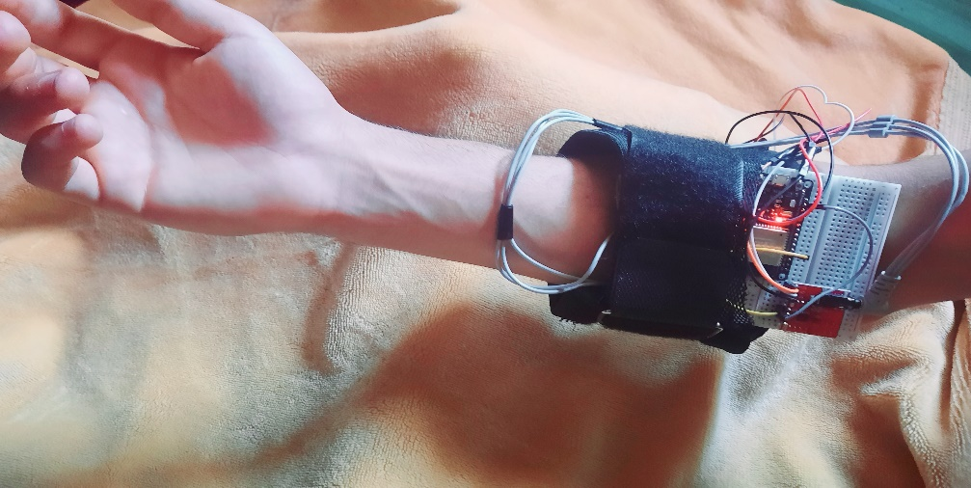
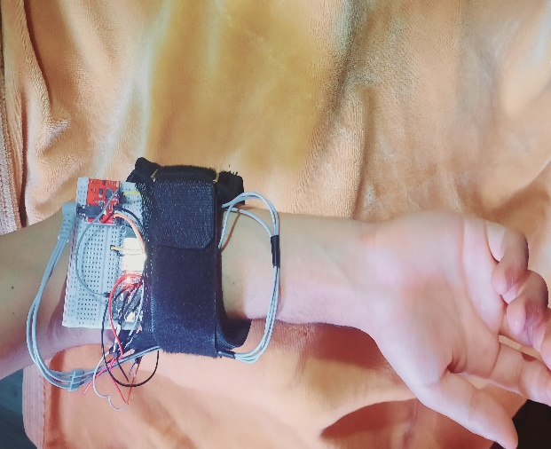
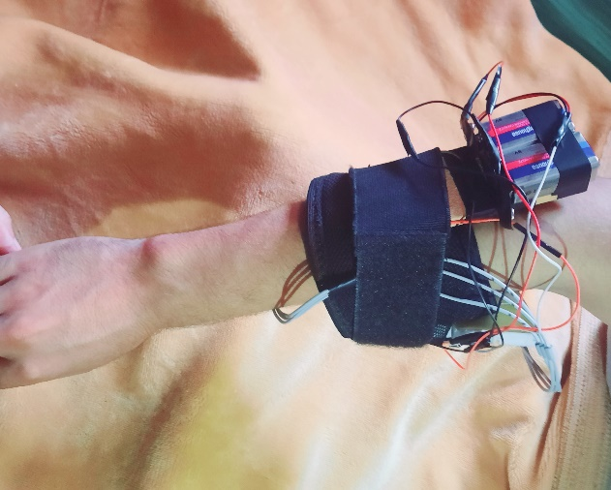
Final Result

Slide 16
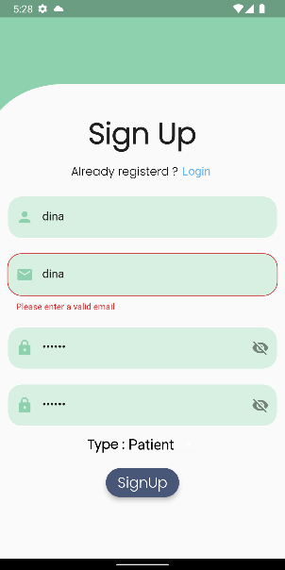

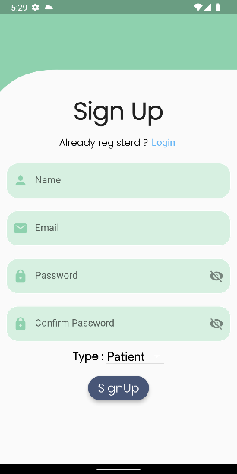
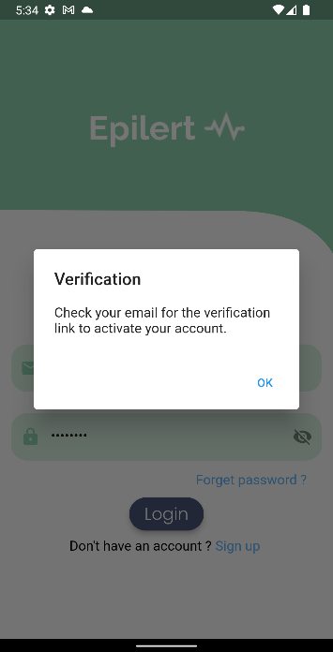
Common screens

Slide 17
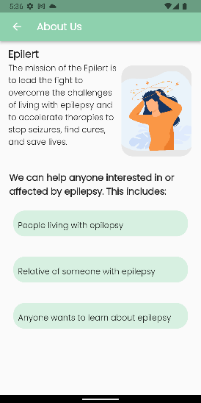
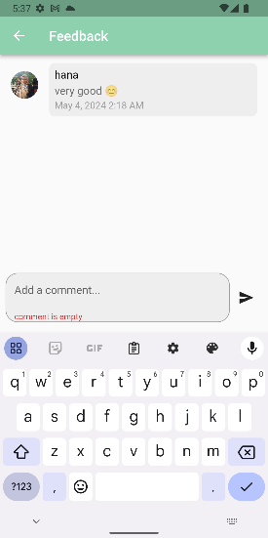
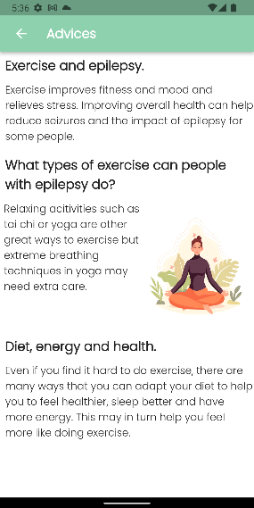
Common screens

Slide 18
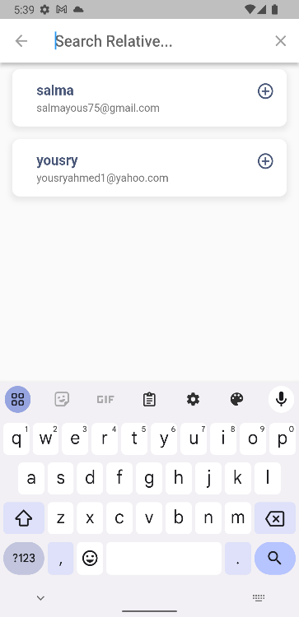
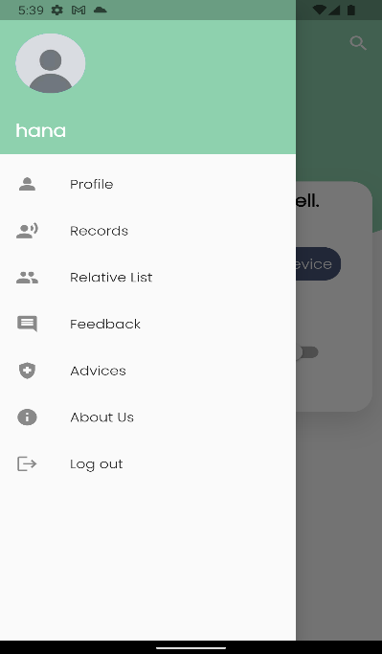
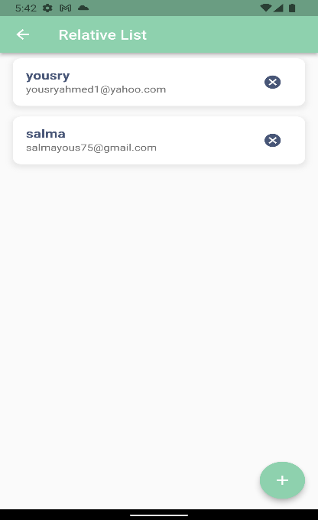
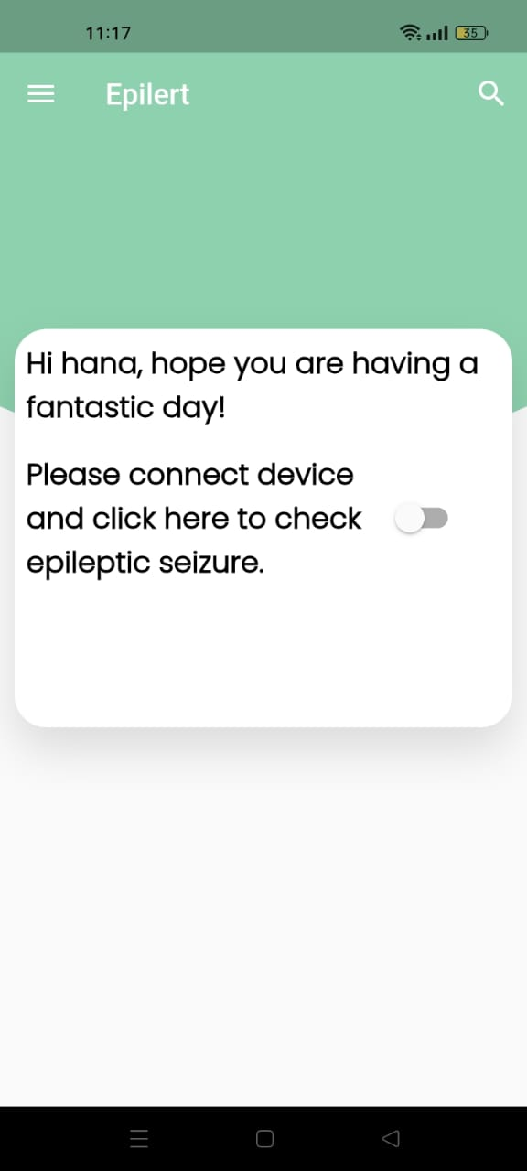
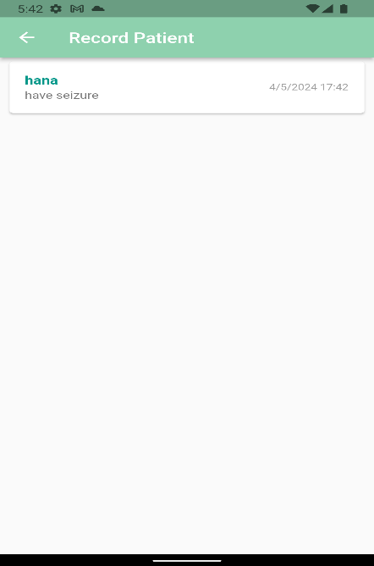
patient screens

Slide 19
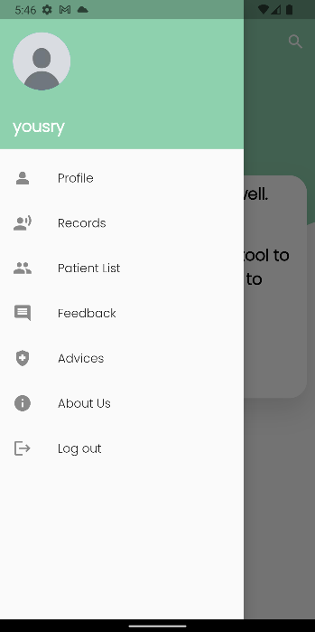
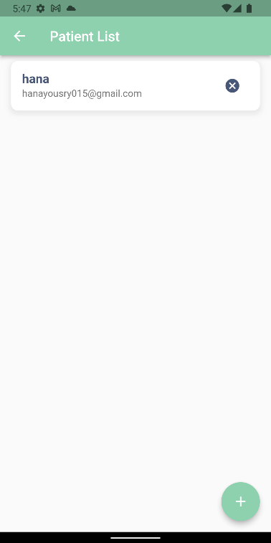
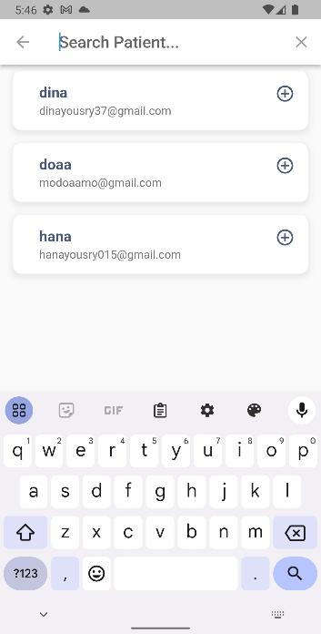
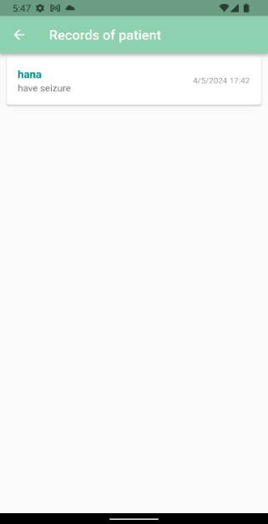
Relative Screens

Slide 20
Deep Learning Model

Slide 21
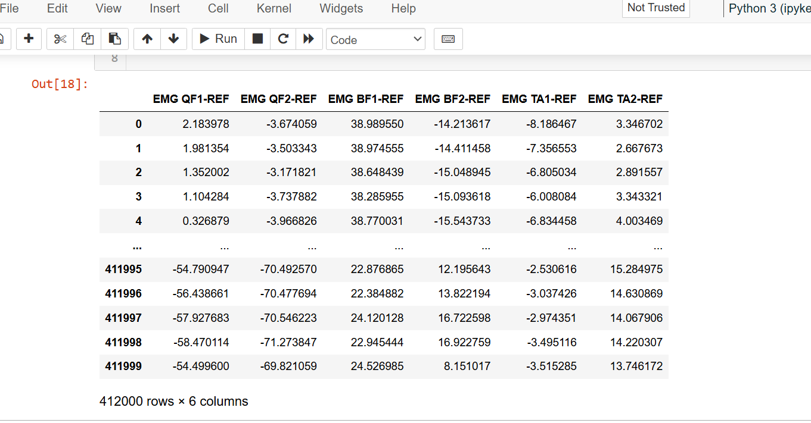
Dataset
Dataset contains 6 columns (Channels of EMG raw signal) and 412000 rows for each file
We have 15 file. Each file contains EMG signals for specific patient.

Slide 22

Data Processing:
EMG Data Collection: The ESP32 device collects EMG signals and sends them via MQTT in a CSV file every minute.
Data Conversion: Convert raw EMG data to a Data Frame.
Filtering: Apply a bandpass filter (10-450 Hz) to isolate relevant muscle activity signals.
Rectification and Normalization: Rectify the signal to positive values and normalize it for consistent data processing.

Slide 23
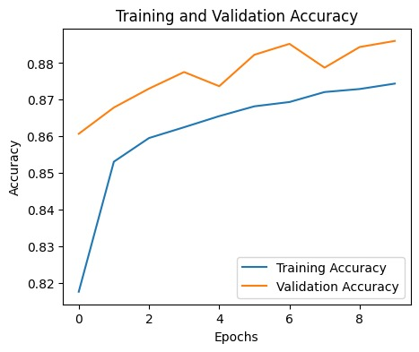
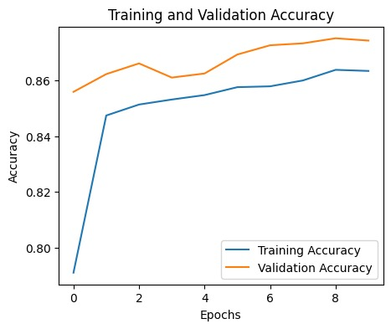
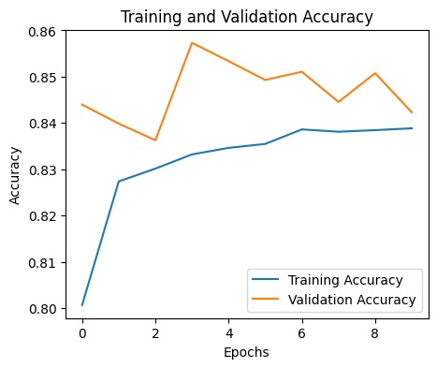
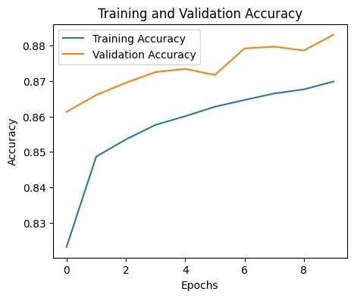
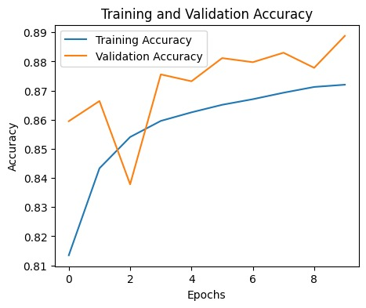
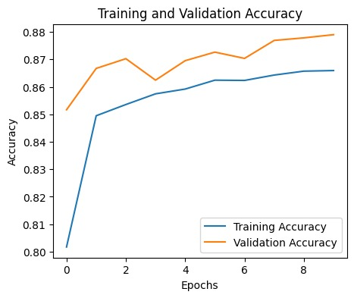
1-bidirectional LSTM 64 Layer 89% 2-GRU 64 Layer 87.5% 3- GRU 128 Layer 87% 4-LSTM 64 Layer 84% 5-LSTM 128 Layer 87% 6-LSTM (Recurrent Regulariser) 0.88 %

Slide 24
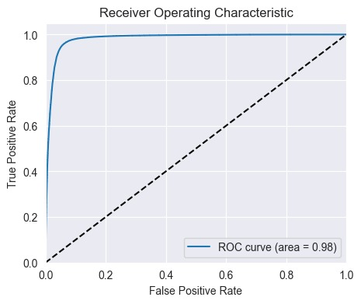
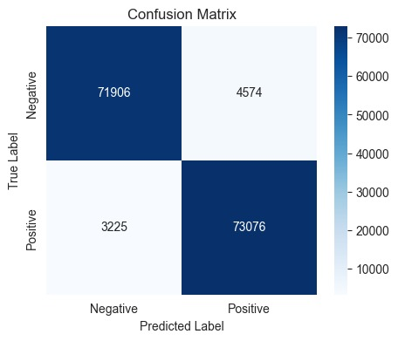
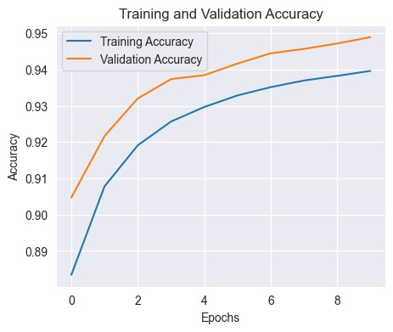
Bidirectional LSTM 128layer

Slide 25
Detection Model:
This model uses a Bidirectional LSTM to identify seizure patterns:
Architecture:
Two Bidirectional LSTM layers with 128 units each
Dropout layers for regularization
Final Dense layer with sigmoid activation for binary classification
Optimization:
Binary cross-entropy loss
Adam optimizer

Slide 26



Notification System:
Flask API:
Receive classification results.
Update Firebase Realtime Database with the results.
Flutter App:
Listen for updates in Firebase.
Send alerts and activate alarms for caregivers if a seizure is detected.

Slide 27
Test
1-Hardware Test Cases
2-Connection Test Cases
3-Mobile Application Test Cases
4-Functional Testing

Slide 28
1-Hardware Test Cases
Test title | Test conditions | Preconditions | Test steps | Expected output | Actual output | Status
Powering EMG | The EMG is powering. | The battery is charged (2 batteries 9v). | Wearing electrodes Of EMG And ESP32 is powered on. | Serial receive signals range from 300 to 5000. | Serial received signals in written range. | PASS
 | Delay while powering EMG. |  |  |  | Signal imbalanced. | PASS
 | The EMG doesn’t work. |  |  |  | No signal received. | FAIL
Check ESP32 | ESP32 is working. | The battery is charged (3.7v). | Connect Lithium battery. | ESP32 led on. | ESP32 led on. | PASS
 | ESP32 not working. |  |  |  | ESP32 led off. | FAIL
Check Lithium battery and charge module | Lithium battery is charging | Connection established and charger with 5v and 1A. | Connect lithium battery to charger. | Charger module blue led is on. | Blue led on. | PASS
 | Lithium battery is not charging. |  |  |  | Blue led off | FAIL

Slide 29
2-Connection Test Cases
Test title | Test conditions | Preconditions | Test steps | Expected output | Actual output | Status
Check serial connection | If Baud rate is 9600. | UART is enabled. | Code executed on ESP32. | Data received on the server and can be visualized in serial monitor. | Data received. | PASS
 | If Baud rate is not 9600. |  |  |  | Data not received. | FAIL
Check Wi-Fi connection | If Wi-Fi enabled in pc. | Knowing Ip configuration of available network. | Enable hotspot and ESP32 is powered. | Print in serial WIFI connected and IP of network. | Print in serial WIFI connected and IP of network. | PASS
 | If Wi-Fi not enabled in pc. |  |  |  | Print “.”until connection retrieved. | FAIL
Check MQTT connection | If MOSQUITTO broker is enabled. | Establishing MOSQUITTO libraries in pc. | Prepare MOSQUITTO files with TEST.CONF file that contains type of connection not secure, port 1883). | Data received in MQTTCLI with topic. | Data received in MQTT CLI with topic. | PASS
 | If MOSQUITTO broker isn’t enabled |  |  |  | No data received in MQTT CLI | FAIL
Check PYTHON_MQTT subscriber | if topic is found. | Topic is founded and python. PAHO library is installed. | Identify same topic in MQTT then port of MQTT (1883) with IP of network to receive data. | Data received in python and created EMG RECORDS. | Data received in python and created EMG RECORDS. | PASS
 | If topic not found. |  |  |  | Data not received in python. | FAIL
Check app.py file (model connection) | If new EMG RECORD found. | Flask API connected to PYTHON_MQTT subscriber. | Installed required libraries for Flask API. | Create new record if data were sent to model and send results of model to firebase. | File (processed in model) created then sent to firebase. | PASS
 | If new EMG RECORD not found. |  |  |  | No file (processed in model) created or sent to firebase. | FAIL

Slide 30
3-Application Test Cases
Test Case ID | Description | Steps | Expected Result
2.1 | Valid Sign Up | 1. Navigate to the sign-up page. 2. Enter valid information in all required fields. 3. Click on the sign-up button. | User is successfully registered and redirected to login page.
2.2 | Invalid Sign Up (Existing Username) | 1. Navigate to the sign-up page. 2. Enter an already existing username. 3. Fill in other required fields and click sign-up. | User receives an error message indicating username is taken.
2.3 | Password Mismatch | 1. Navigate to the sign-up page. 2. Enter different passwords in the password and confirm password fields. 3. Click on the sign-up button. | User receives an error message indicating passwords do not match.

Slide 31
3-Application Test Cases
Test Case ID | Description | Steps | Expected Result
3.1 | View Profile | 1. Log in to the application. 2. Navigate to the profile page. | User can view their profile information.
3.2 | Edit Profile | 1. Log in to the application. 2. Navigate to the profile page. 3 Click on the edit button. 4. Update profile information. 5 Click save. | Profile information is updated successfully.

Slide 32
3-Application Test Cases
Test Case ID | Description | Steps | Expected Result
4.1 | Connect New Device | 1. Log in to the application. 2. Navigate to the devices page. 3. Click on "Add Device" button. 4. Enter device details and click connect. | Device is successfully connected and listed in user's devices.
4.2 | Disconnect Device | 1. Log in to the application. 2. Navigate to the devices page. 3. Select a connected device and click "Disconnect" button. | Device is successfully disconnected and removed from user's devices.

Slide 33
3-Application Test Cases
Test Case ID | Description | Steps | Expected Result
5.1 | Search Patient by Name | 1. Log in to the application. 2. Navigate to the patient search page. 3. Enter a patient's name in the search field and click search. | Search results display patients matching the entered name.
5.2 | Search Patient by ID | 1. Log in to the application. 2. Navigate to the patient search page. 3. Enter a patient's ID in the search field and click search. | Search results display the patient with the matching ID.
5.3 | Search Patient with No Results | 1. Log in to the application. 2. Navigate to the patient search page. 3. Enter a random name or ID that does not exist and click search. | No results found and an appropriate message is displayed.

Slide 34
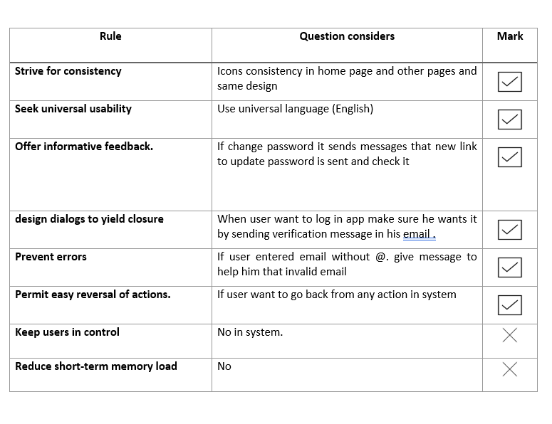
The Eight Golden Rules

Slide 35
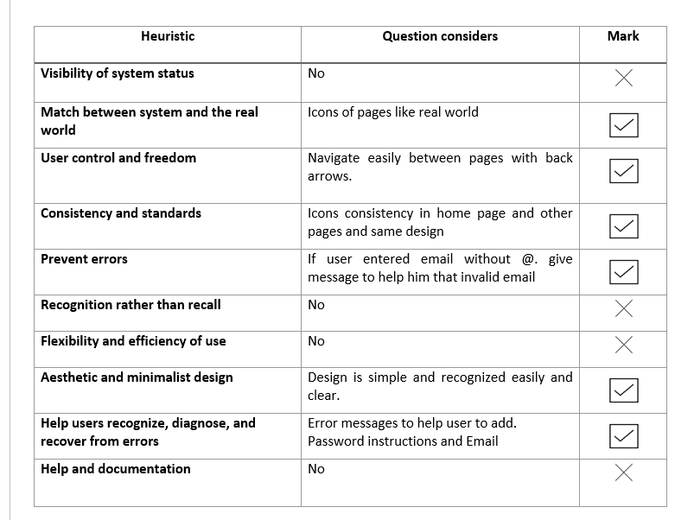
Nielsen's 10 Usability Heuristics

Slide 36
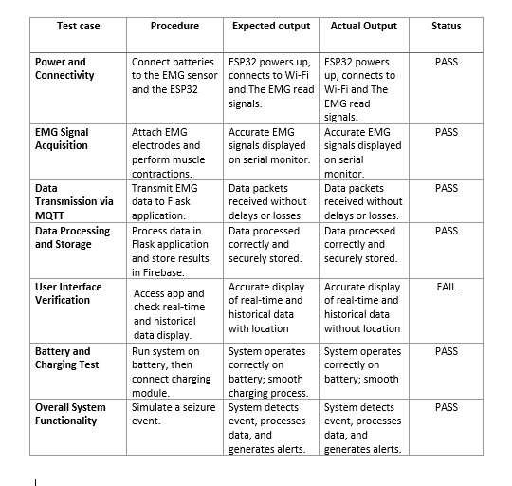
4-Functional Test

Slide 37
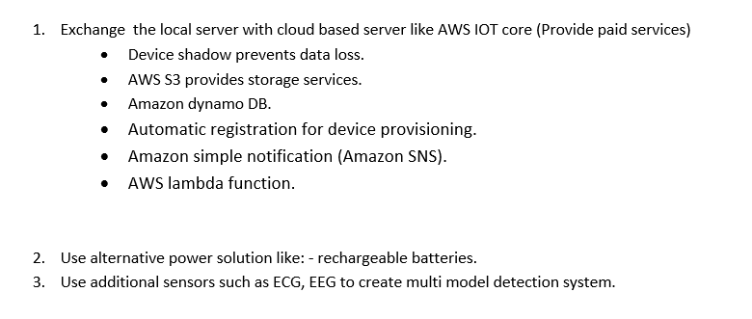

Recommendation and Future Work .

Slide 38
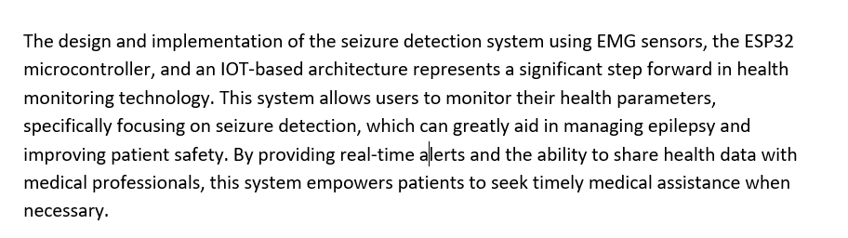
Conclusion .

Slide 39
THANK YOU
Learn More

